Slide 1

Clustering Countries Based
On Their Socio-Economic
Performance

Slide 2
Business Problem:
Perform Clustering(Hierarchical, Kmeans & DBSCAN) on World development measurement data, identify the number of clusters formed based on their socio economic development and draw inferences

Slide 3
Project Architecture / Project Flow
Loading Dataset
Descriptive Analysis
Dealing With Null Values
How?
Imputation
By Mean, Median, Mode
KNN,
Linear Regression
Deletion
If you have large volume of data

Slide 4
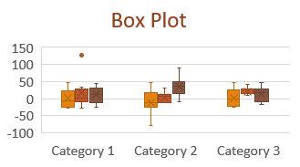
Project Architecture / Project Flow
Outlier Handling
Visualization
Data Preprocessing
Scatterplot and Pie plot
Feature Transformation OHE, pd.get_dummies
Feature Scaling MinMaxScaler
PCA

Slide 5
Project Architecture / Project Flow
Model Building
Model Deployment
K-Means
DBSCAN
Hierarchical

Slide 6
Data set details
We have World development measurement dataset which consists of 2704 rows and 25 columns. To say it in other way, we have records for 208 countries 25 socio-economic indicators for 13 years.
One problem we face is the huge numbers of missing values. i.e. 11740 cells are missing
We observe that entries for big countries are properly maintained where the most of the null entries are associated with small countries like marshal islands.
Columns like Ease of Business have 93% entries as null.

Slide 7
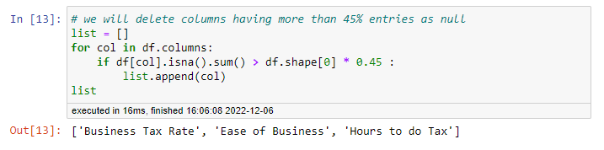
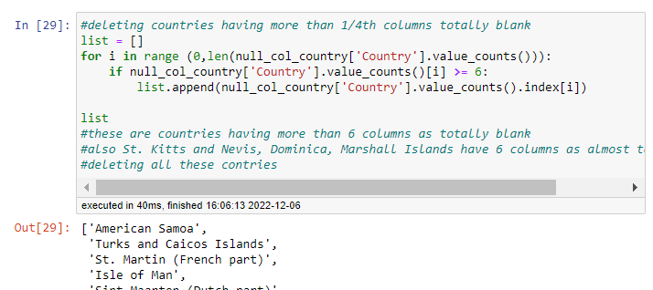
Exploratory Data Analysis (EDA) – Handling NaN
Deletion of Columns
Deleting columns having more than 45% entries as null
Deletion of Rows
Deleting records of those countries having 1/4th columns totally blank

Slide 8
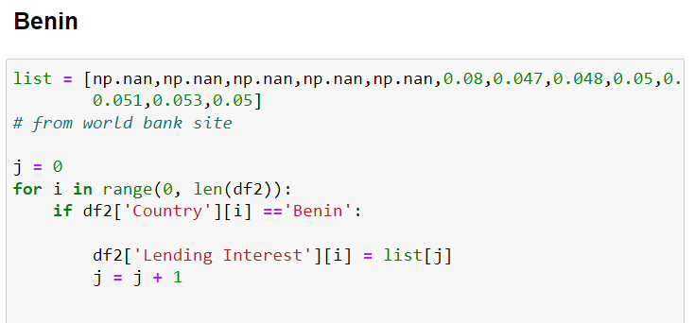
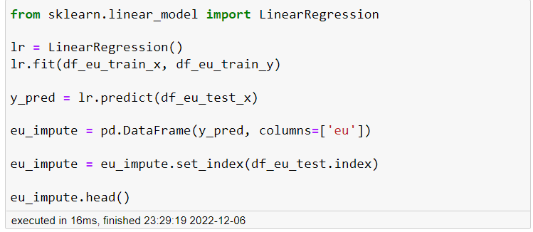
Exploratory Data Analysis (EDA) – Handling NaN
Inserting From online Resources
To fill missing values in realistic manner, we surf websites to find missing values.
Imputation
With SLR
For those features where correlation is almost perfect(99%), we use Linear Regression on one feature to predict missing values of another feature

Slide 9
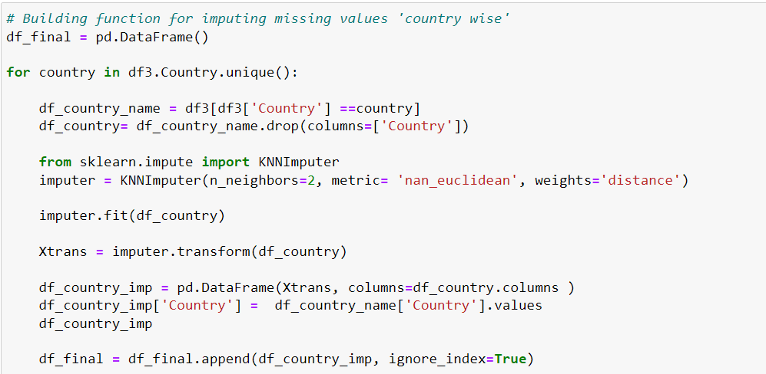
Exploratory Data Analysis (EDA) – Handling NaN
Imputation
With KNN
We are segregating our data w.r.t. countries and applying Knn imputer. If we apply Knn imputer on whole dataset, then for imputing Cuba’s GDP model will also consider USA’ s GDP and it will result in unrealistically inflated depiction of Cuba’s GDP

Slide 10

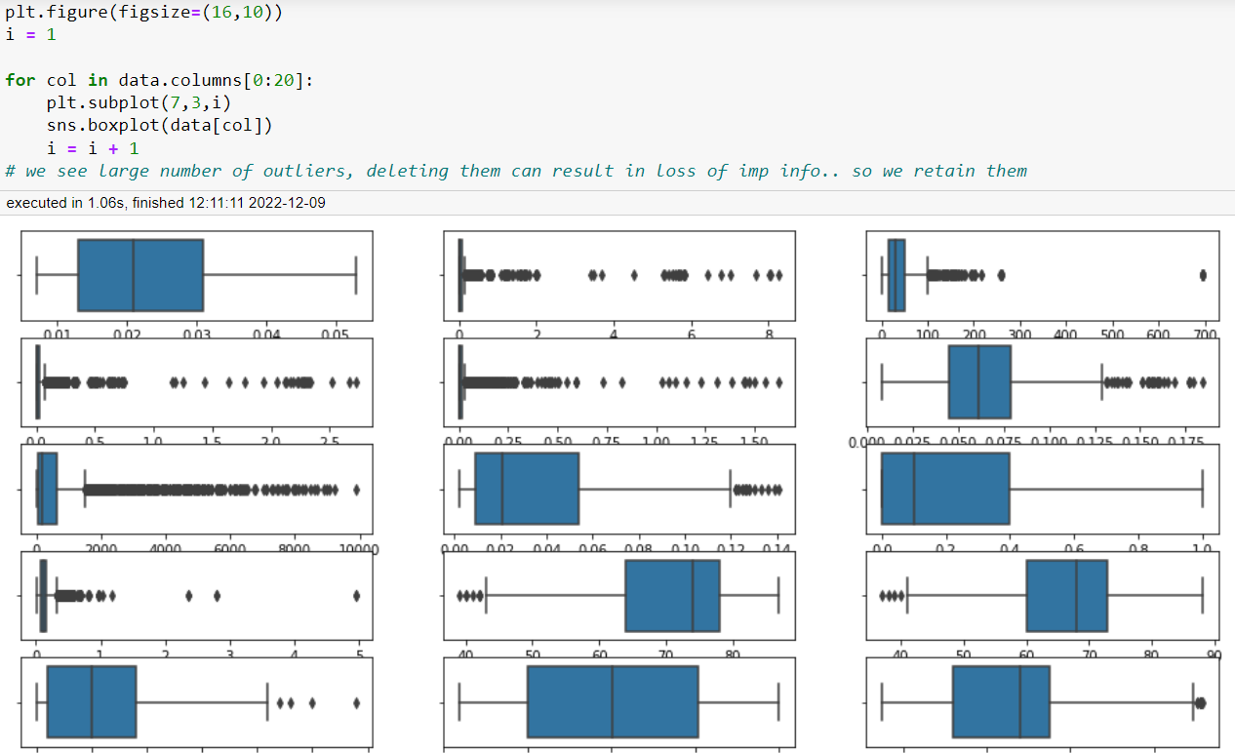
Exploratory Data Analysis (EDA) –Outliers Detection
A lot of outliers, deleting leads to loss of data, hence we retain them

Slide 11
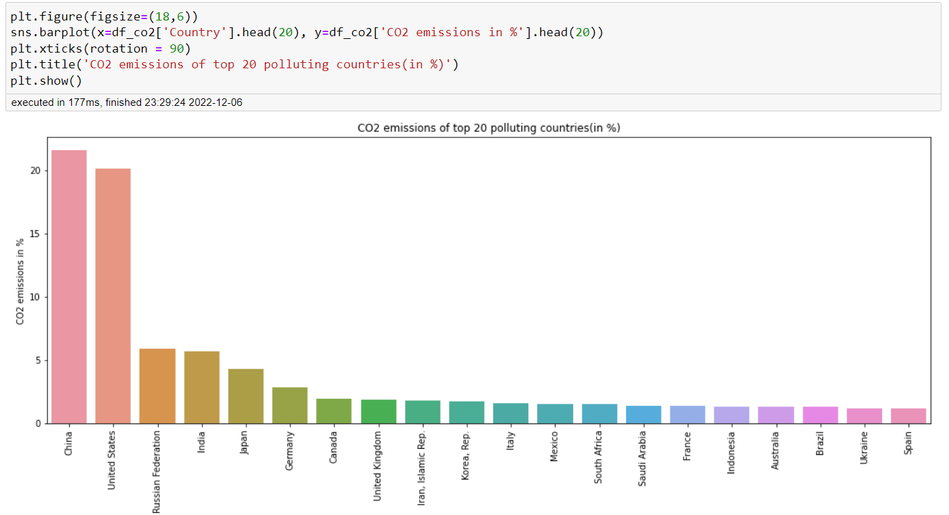
Exploratory Data Analysis (EDA) – Visualization
CO2 Emission

Slide 12
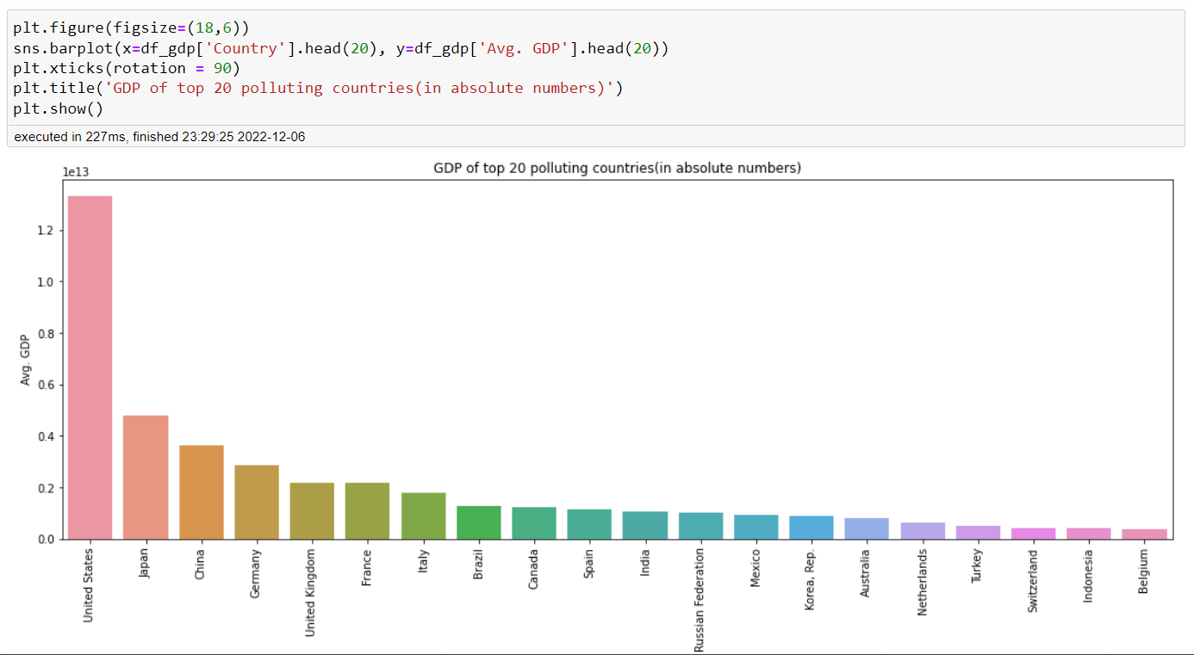
Exploratory Data Analysis (EDA) – Visualization
GDP

Slide 13
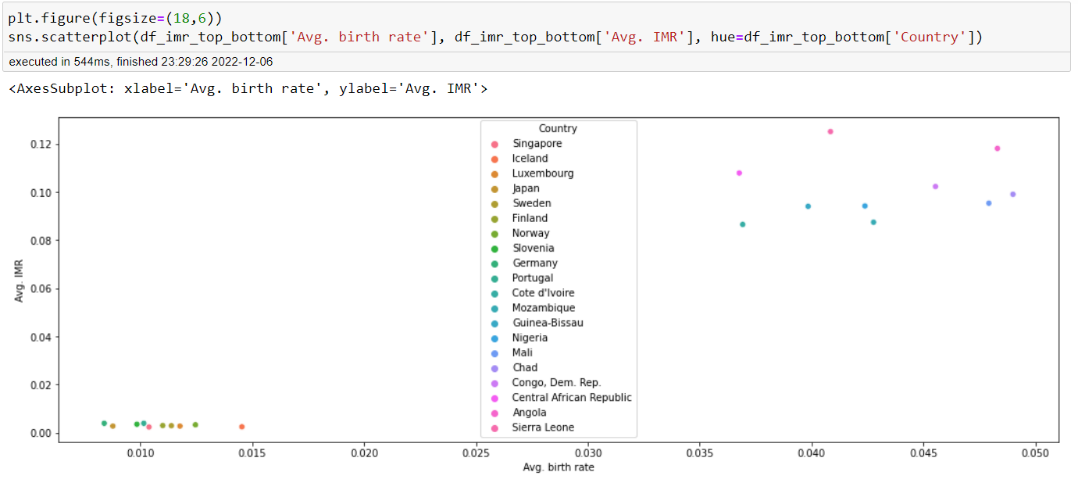
Exploratory Data Analysis (EDA) – Visualization
IMR

Slide 14
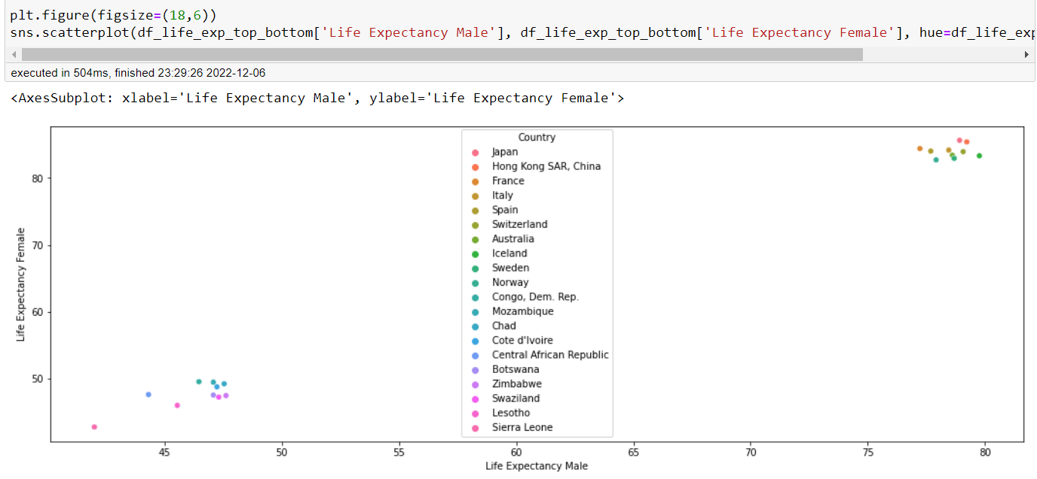
Exploratory Data Analysis (EDA) – Visualization
Life Expectancy

Slide 15
Exploratory Data Analysis (EDA) – Visualization
Insights:
1.China, USA, Russia, India accounts for 50% of CO2 emissions of the world
2.GDP of USA is so huge that it is comparable to GDP of Japan, China, Germany, UK combined
3.Countries like Singapore, Iceland, Luxembourg, Japan, and Nordic countries have highest standards of population health, where as African countries like Cote d'Ivoire, Mali, Nigeria, Chad, Congo etc. severely lack health facilities
4.Countries like Japan, Hong Kong, France, Italy, Spain etc. have high standards of living whereas countries like Congo, Chad, Botswana, Zimbabwe etc. are engulfed in poverty which gives rise to poor health and living standards which ultimately results into lesser life expectancy
5.Health Expenditure is the financial resources that a country devotes to health care, both for individuals and for the population as a whole. It indicates government and total expenditure on health resources, access and services and nutrition. African countries severely lack on this parameter,

Slide 16
Exploratory Data Analysis (EDA) – Visualization
Insights:
6.UAE, Qatar, Macao, Hong Kong has almost 80% of population as workforce which signifies their 'demographic dividend' (though large proportion of their workforce are immigrants)
7.Japan, Italy, Germany has largest proportion of aged population, it results in supply shortage of human resources and increases health expenditure on elderly
8.Uganda, Niger and Afghanistan has largest proportion of population in age group 0-14. This indicates almost 50% of their population is economically unproductive and are considered as liabilities. This segment of population demands huge expenditure on their health and education.
Uganda, Niger, Afghanistan have proportion of aged people below 3%. This indicates low life expectancy :(
9.India and China combined has almost 40% of worlds population. Such a large population with suitable skillsets can be turned into engines of economy.

Slide 17
Exploratory Data Analysis (EDA) – Visualization
Insights:
10.Nordic countries, Canada, Korea top in terms of technological advancements whereas African countries like Mali, Niger, Mozambique, lack internet connectivity
11.Countries like Australia, Canada, Iceland, US indicates political stability, Infrastructural advancement, stable financial system. Whereas, huge time taken in Suriname, Guinea-Bissau, Haiti indicates political instability, red-tapism, infertile atmosphere for entrepreneurial spirit
12.Urbanization refers to the population shift from rural to urban areas, and corresponding decrease in the proportion of people living in rural areas. It takes place due to Employment opportunities, educational institutions and urban lifestyle and health facilities in cities. Usually urbanized countries are considered as industrialized countries because both urbanization and industrialization happens hand in hand.
Macao, Hong Kong, Singapore, Kuwait, Qatar, Belgium are fully urbanized countries, whereas Burundi, Malawi, Uganda, Papua New Guinea, Trinidad and Tobago have almost 80-85% population living in rural areas, which indicates their slow pace of life and economic development.

Slide 18
Exploratory Data Analysis (EDA) – Visualization
Insights:
12. Japan, Portugal, Luxembourg, Austria etc have lowest Lending Interest which results in more loan demands, more investments, more returns, more growth. Whereas high and volatile Lending Interest of Afghanistan, Zimbabwe, Angola, Brazil indicates fragile financial system and infertile atmosphere for investments and growth.
13.With exception of Turkey, Thailand and Mexico all remaining 17 countries are developed countries, which indicates preference of tourists
14.Food, clothes, shelter are considered as fundamental needs of humans, when these need are satisfied then we move towards leisure and entertainment. Tourism is one such recreational activity which people pursue when all their basic needs are satisfied and they have surplus money left. High expenditure on tourism by citizens of US, Germany, UK, France, Japan indicates that living standards of these people are very high.

Slide 19
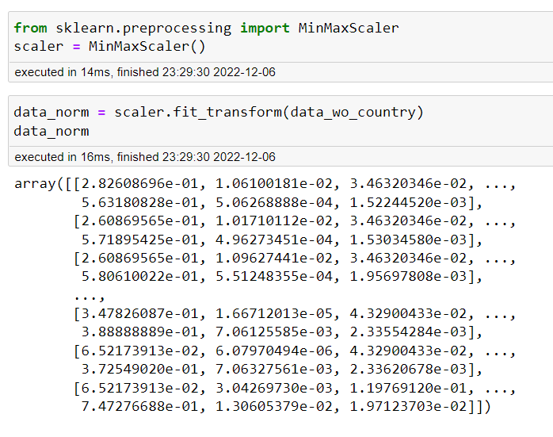
Data Preprocessing – Feature Transformation and Feature Scaling
But here, we are not performing feature transformation, as we have only one categorical column which is ‘Country’ and we have dropped that column since we don’t want countries to get clustered based on their names, but on their performance.
Feature Transformation
One Hot Encoder()
pd.get_dummies()
Feature Scaling
MinMaxScaler()
StandardScaler()

Slide 20
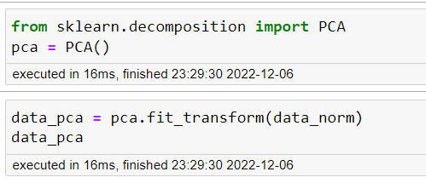
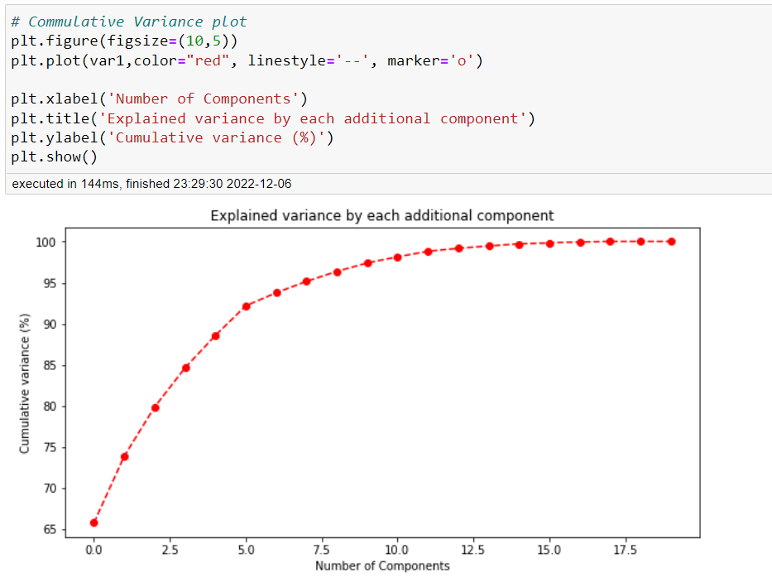
Data Preprocessing – PCA
We have 21 columns in our cleaned dataset, we want to reduce number of columns and keep only those columns which add value to our model performance, hence we perform PCA

Slide 21
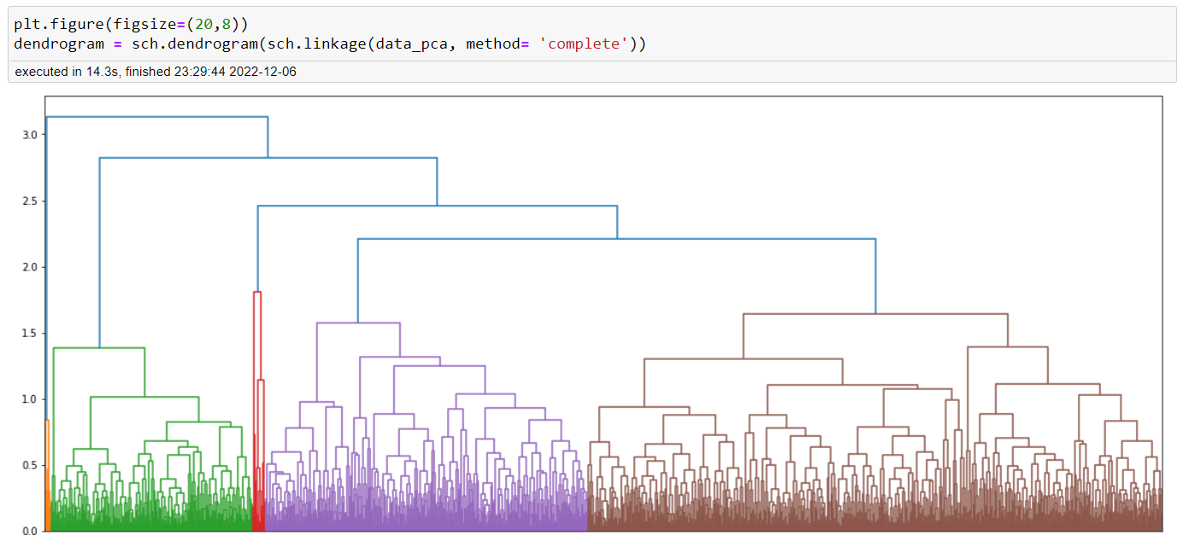
Model Building
K-Means
DB SCAN
Hierarchical Clustering

Slide 22
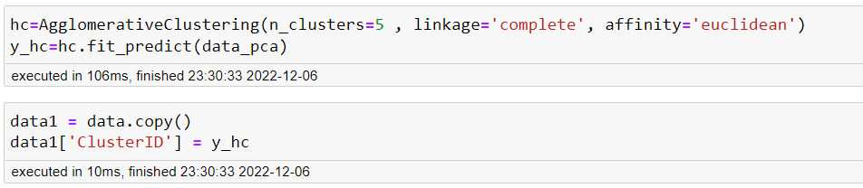
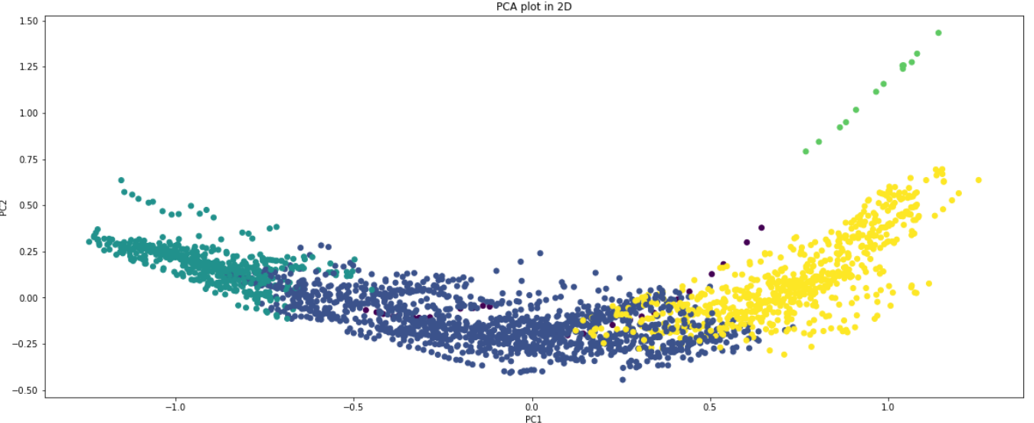
Model Building
Hierarchical
Clustering
Complete Linkage with n = 5

Slide 23
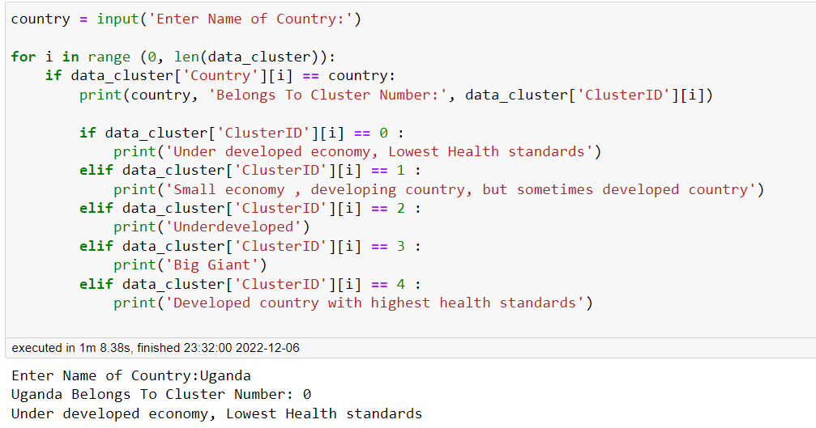
Model results – Hierarchical Clustering
Data set details: Cleaned data with normalization and PCA is of 2366 rows and 13 columns
Algorithm Name: AgglomerativeClustering
Configuration: no. of clusters = 5 , linkage = Complete , affinity = Euclidean
Data Partition details: Entire cleaned data is fed to model

Slide 24
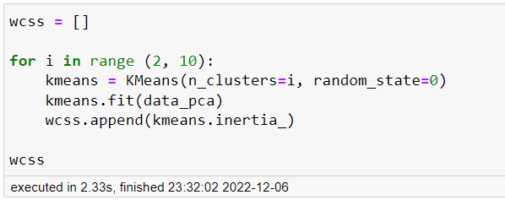
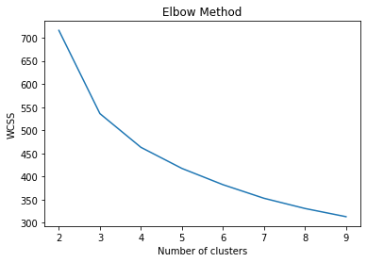
Model Building
K-Means
The K-means clustering algorithm computes centroids and repeats until the optimal centroid is found. It is presumptively known how many clusters there are. It is also known as the flat clustering algorithm. The number of clusters found from data by the method is denoted by the letter 'K' in K-means.

Slide 25
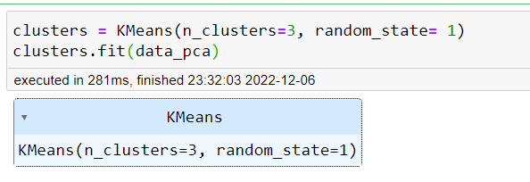
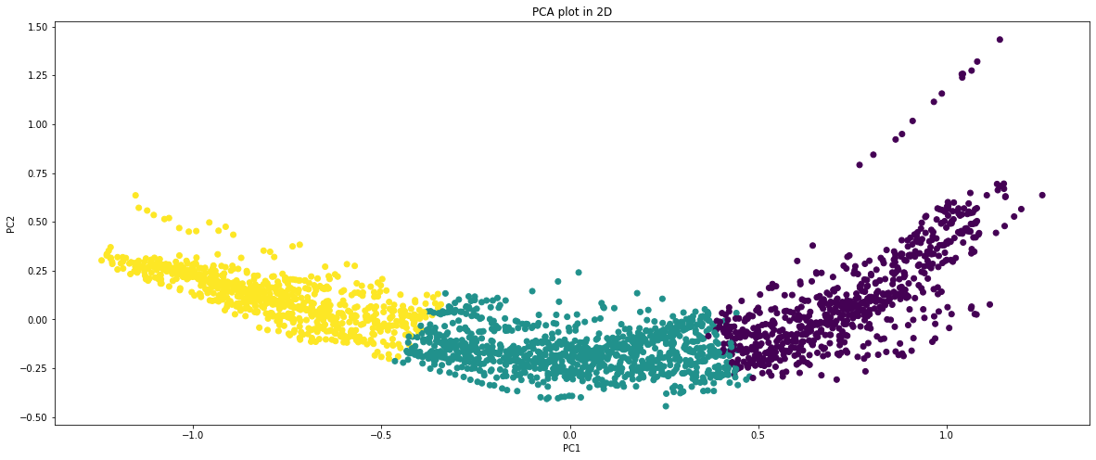
Model Building
K-Means

Slide 26
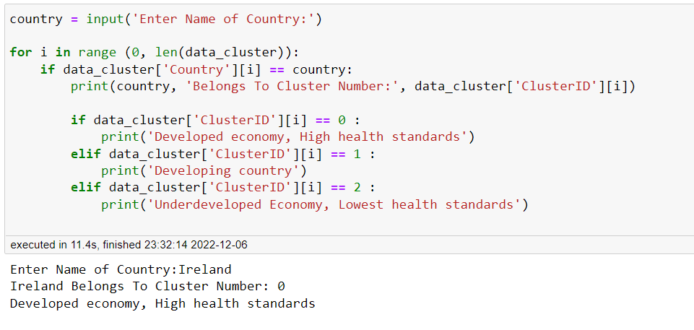
Model Results: K-Means
Data set details: Cleaned data with normalization and PCA is of 2366 rows and 13 columns
Algorithm Name: Kmeans
Configuration: no. of clusters = 3 , maximum iteration =300
Data Partition details: Entire cleaned data is fed to model

Slide 27
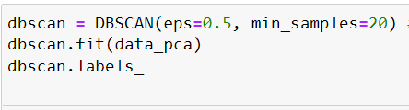
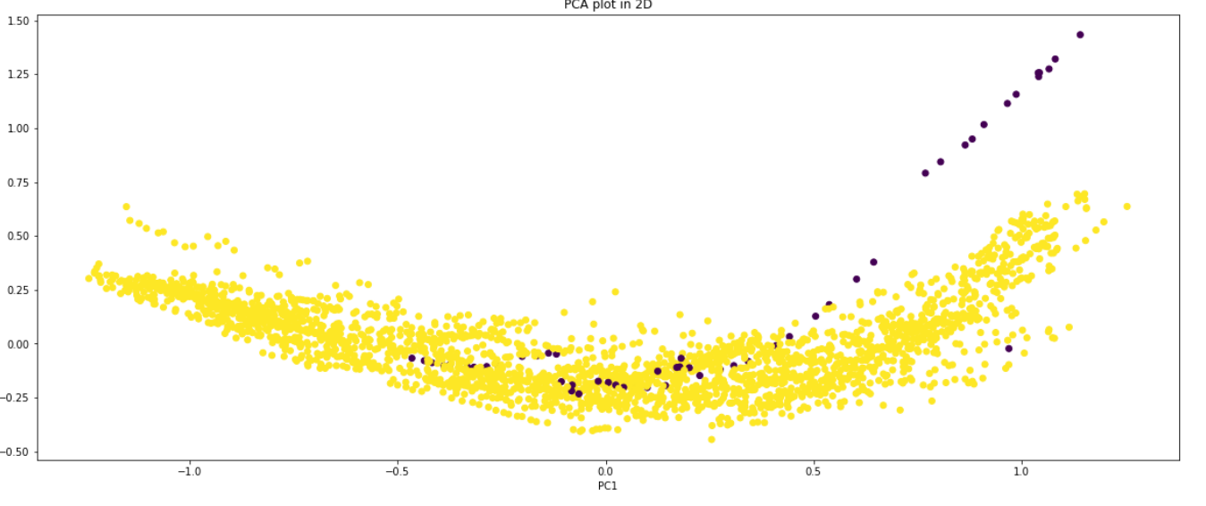
Model: DB SCAN
Data set details: Cleaned data with normalization and PCA is of 2366 rows and 13 columns
Algorithm Name: DBSCAN
Configuration: eps=0.5, min samples=20
Data Partition details: Entire cleaned data is fed to model

Slide 28
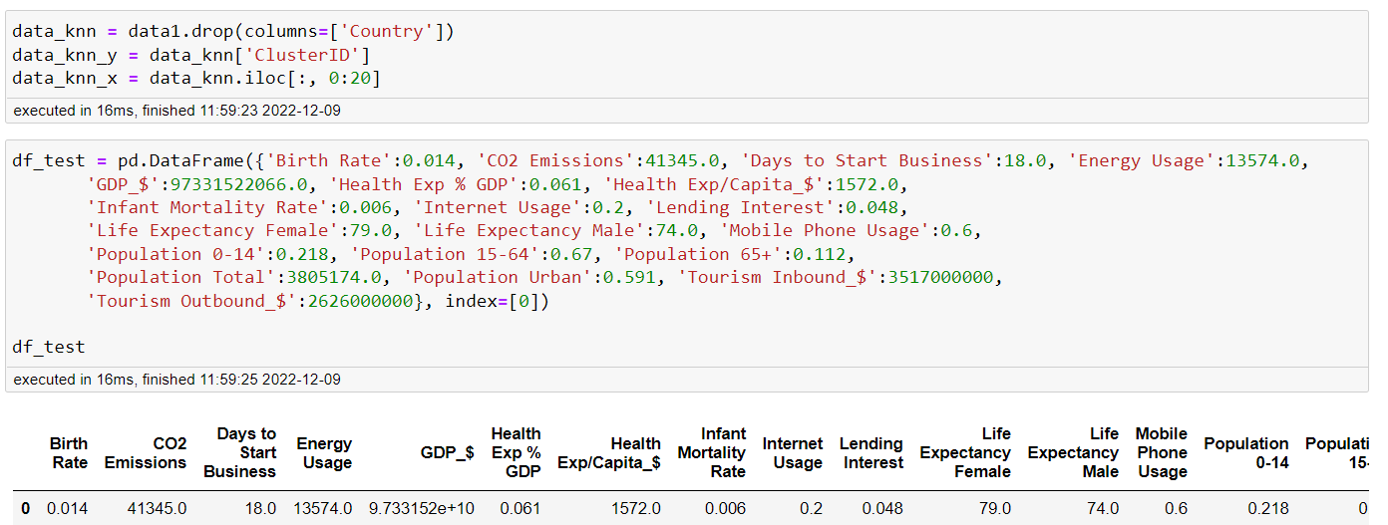
Model: KNN
Here, we will give some random values of socio economic parameters and check which cluster it will belong

Slide 29
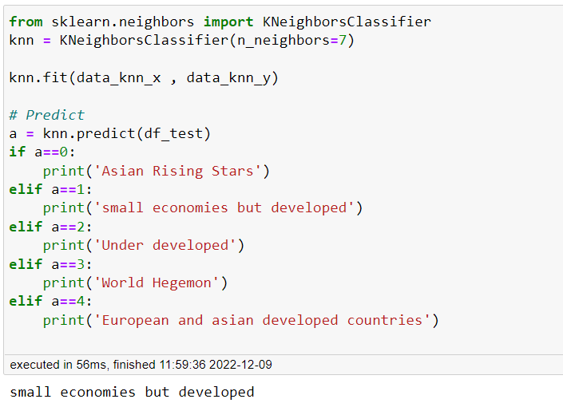
Model Results: KNN

Slide 30
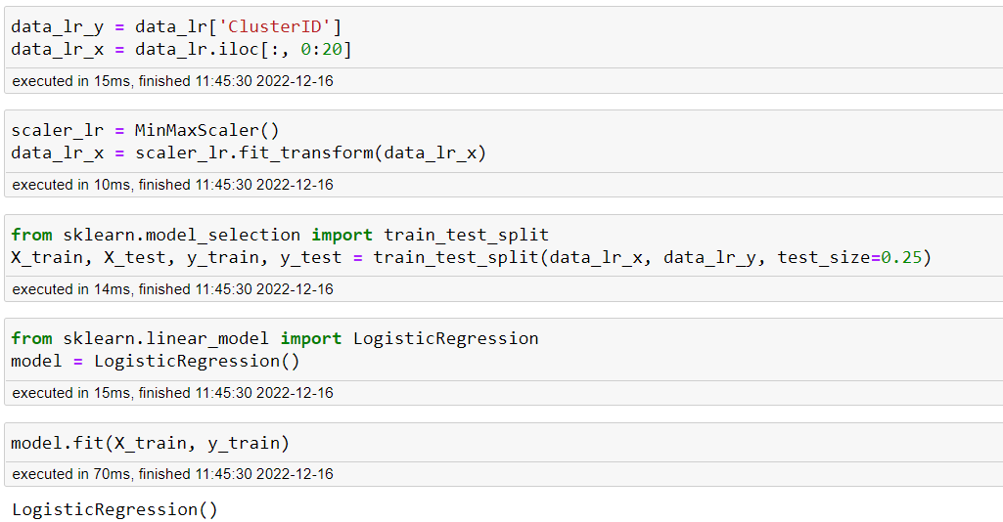
Model Building: Logistic Regression
We now use our dataset and output of clustering model to train a classification model.

Slide 31
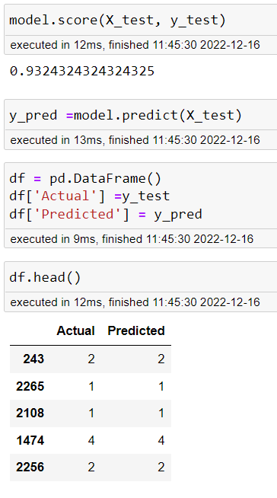
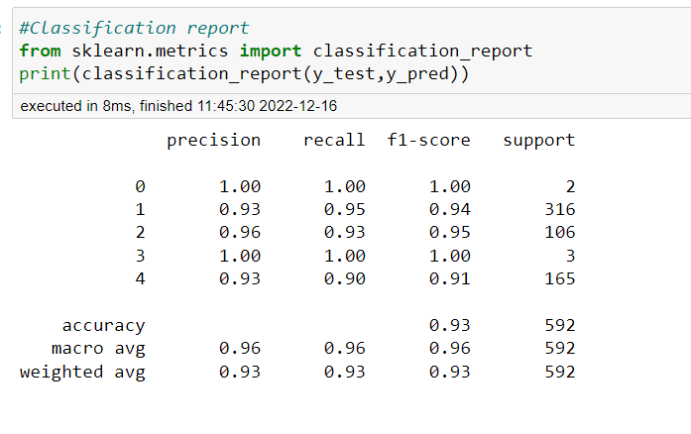
Model Prediction and Performance: Logistic Regression
Prediction
Performance
Overall Accuracy is 93%

Slide 32
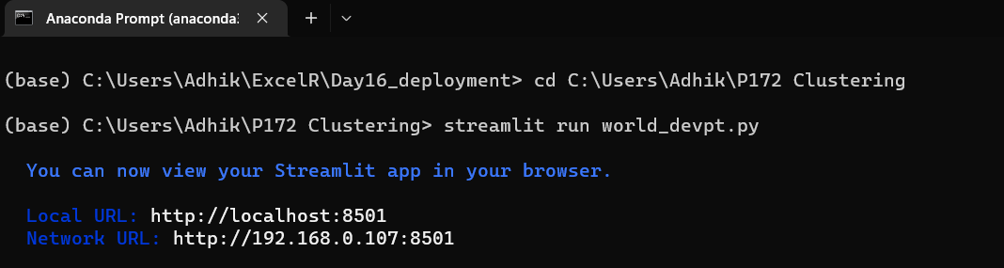
Model Deployment (Logistic Regression) on Streamlit
We are initializing Anaconda Prompt in order to deploy our python file on streamlit

Slide 33
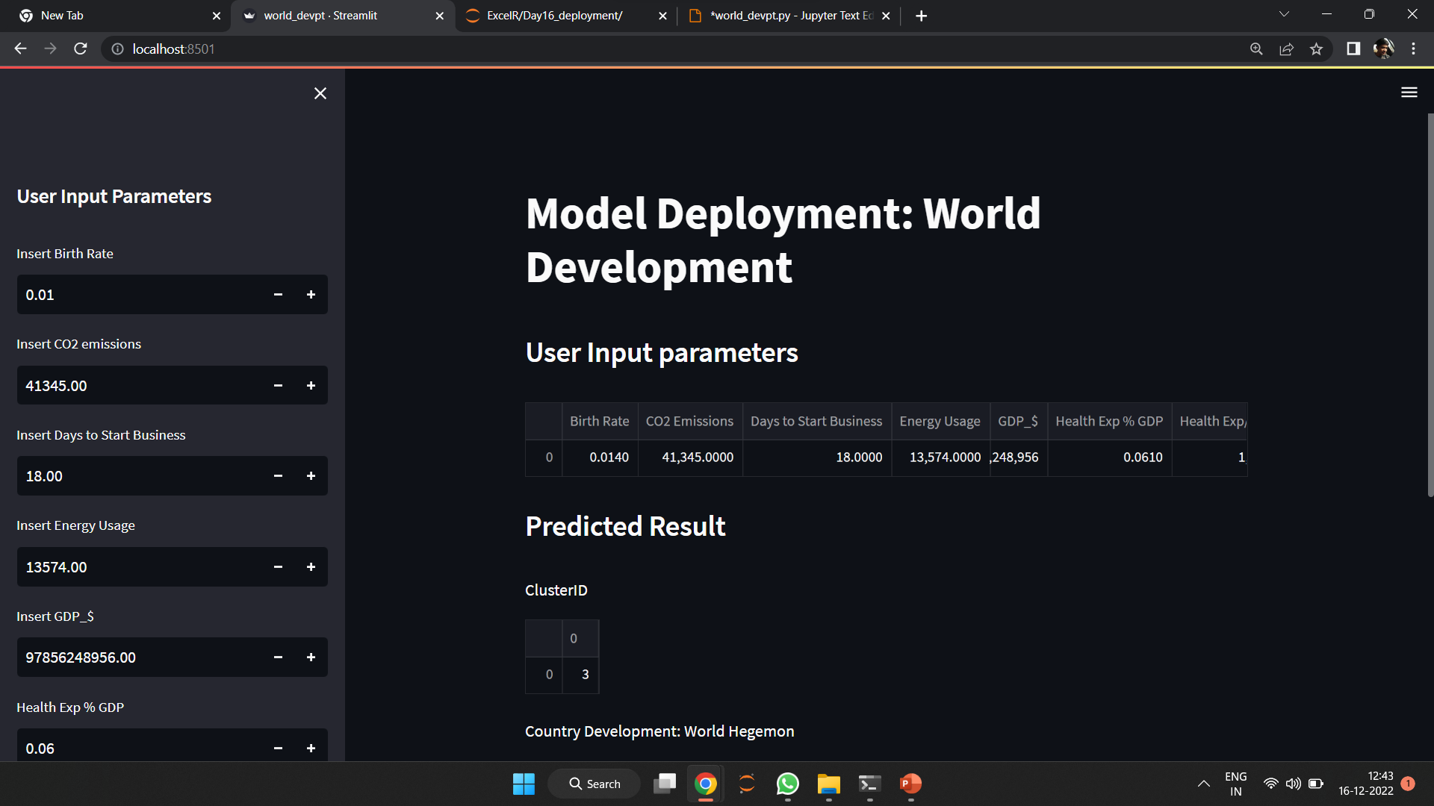
Model Deployment (Logistic Regression) on Streamlit

Slide 34
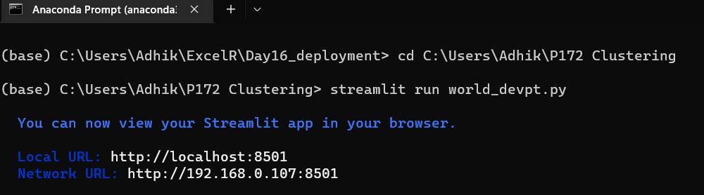
Model Deployment (Knn) on Streamlit
We are initializing Anaconda Prompt in order to deploy our python file on streamlit

Slide 35
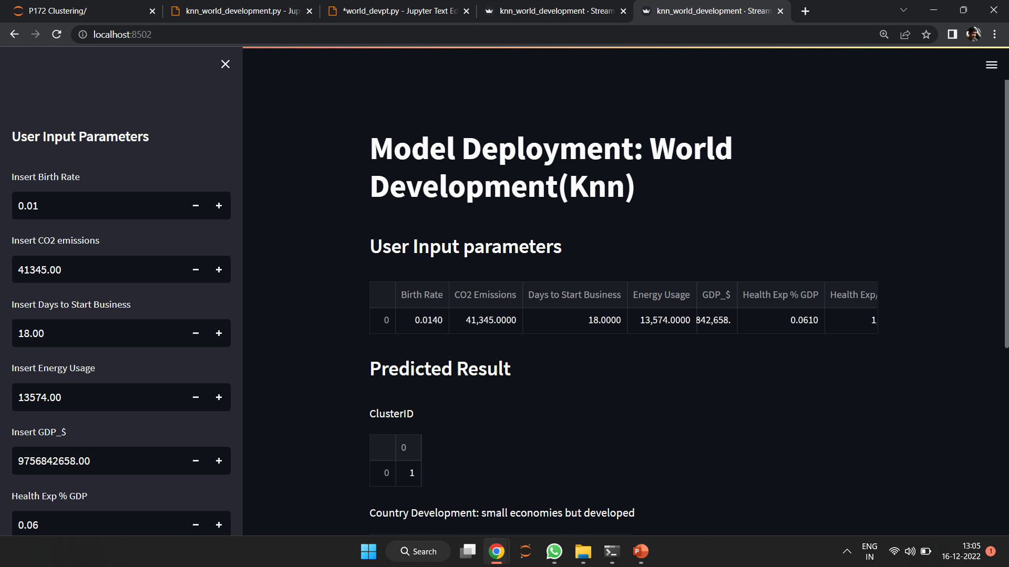
Model Deployment on Streamlit

Slide 36
Challenges faced?
Dealing with 11.7k missing values was a big challenge we encountered
How did you overcome?
Firstly we deleted columns with more than 45% entries as missing since we cant use minor portion of data to impute major portion of column.
Initially we used median imputation where we safely could.
Then we used Single Linear Regression to predict missing values of energy usage since it had strong linear relationship with CO2 emission.
Then we applied Knn imputer on each country ‘separately’ since apply imputer on whole dataset at once leads to distortion. i.e. GDP of USA leads to over estimation of GDP of Uganda.

Slide 37
Thank You

